Slide 1
Car Price Prediction Using Machine Learning
Guided by :-
Er. Kirandeep Kaur (E14583)
Assistant Prof.
Department of CSE
CU Gharuan
Submitted By :-
Inder Dev Singh
24MAI10043
ME-CSE-AIML

Slide 2
Contents
Introduction
Literature Review
Methodology
Implementation
Analysis & Results
Discussions
Conclusion
References

Slide 3
Introduction of Topic
The used car market has experienced significant growth over recent years, with millions of transactions occurring annually. Buyers and sellers are constantly seeking accurate pricing information to make informed decisions. However, determining the appropriate price for a used vehicle can be complex due to numerous influencing factors such as the car’s make, model, year of manufacture, mileage, engine capacity, fuel type, and market demand. Traditionally, pricing has relied on expert opinion or simple estimations, which may not account for all the nuances in the data.
With the rise of data availability and advancements in machine learning, there is a growing opportunity to leverage these techniques to predict used car prices more accurately. Machine learning models can learn patterns from historical car sales data and incorporate various features to estimate prices with greater precision.
This paper aims to develop and evaluate machine learning models to predict car prices based on key attributes. By applying models like Linear Regression, Decision Trees, Random Forests, and Gradient Boosting, this study seeks to compare their performance and identify the most effective model for price prediction. The ultimate goal is to provide a robust tool for pricing in the used car market, benefiting both sellers and buyers.

Slide 4
Research Objectives
The main goal of this research is to develop an accurate machine learning model for predicting used car prices based on various features. The specific objectives of this study are:
Develop Predictive Models: To design and implement machine learning models such as Linear Regression, Decision Trees, Random Forests, and Gradient Boosting for predicting car prices.
Evaluate Model Performance: To assess the performance of different machine learning models using evaluation metrics like Mean Absolute Error (MAE), Mean Squared Error (MSE), and R-squared (R²).
Feature Importance Analysis: To identify and analyze the most influential factors that contribute to car price determination, such as make, model, year, mileage, engine size, and fuel type.
Model Comparison: To compare the accuracy and efficiency of different machine learning models and recommend the best approach for car price prediction.
Provide Insights for the Used Car Market: To offer data-driven insights and recommendations for sellers, buyers, and car dealerships, facilitating more informed pricing decisions in the used car market.
Develop a User-Friendly Tool: To propose the development of a potential web-based or app-based tool that can predict car prices based on input data using the most accurate machine learning model.

Slide 5
Literature Review
Various studies have explored the use of machine learning for price prediction in the automotive industry. Traditional methods, such as linear regression, have been widely used due to their simplicity but often fail to capture complex relationships between car features. Recent advancements in machine learning have introduced more powerful models like Decision Trees, Random Forests, and Gradient Boosting, which handle non-linear relationships and offer better accuracy in predictions. Studies have also shown that incorporating features such as make, model, mileage, year, fuel type, and engine capacity significantly improves model performance. Ensemble methods, in particular, have been shown to outperform single algorithms by reducing overfitting and enhancing generalization. Additionally, some research focuses on the importance of feature engineering, as irrelevant or redundant features can degrade model accuracy. These approaches provide a foundation for developing robust models to predict used car prices effectively.

Slide 6
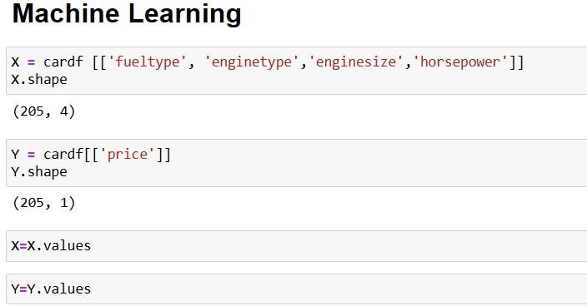
Methodology
Data Pre-processing:
Before training the machine learning models, data cleaning and pre-processing steps are performed:
Handling Missing Values: Missing entries in the dataset, particularly for mileage and price, are handled either through imputation or by discarding the entries.
Encoding Categorical Variables: Features like car make, model, and fuel type are categorical and need to be converted to numerical form using techniques like one-hot encoding.
Normalization: To ensure that all numerical features (e.g., mileage, engine size) are on the same scale, normalization or standardization techniques are applied.
Fig 2. Machine Learning Models

Slide 7
MACHINE LEARNING MODELS
Three primary models are tested for car price prediction:
Linear Regression: A simple model that assumes a linear relationship between car features and prices.
Decision Tree Regressor: A non-linear model that builds a tree structure to predict prices based on feature splits.Kneighbor Regressor:-
KNN regression is a non-parametric method that, in an intuitive manner, approximates the association between independent variables and the continuous outcome by averaging the observations in the same neighbourhood.

Slide 8
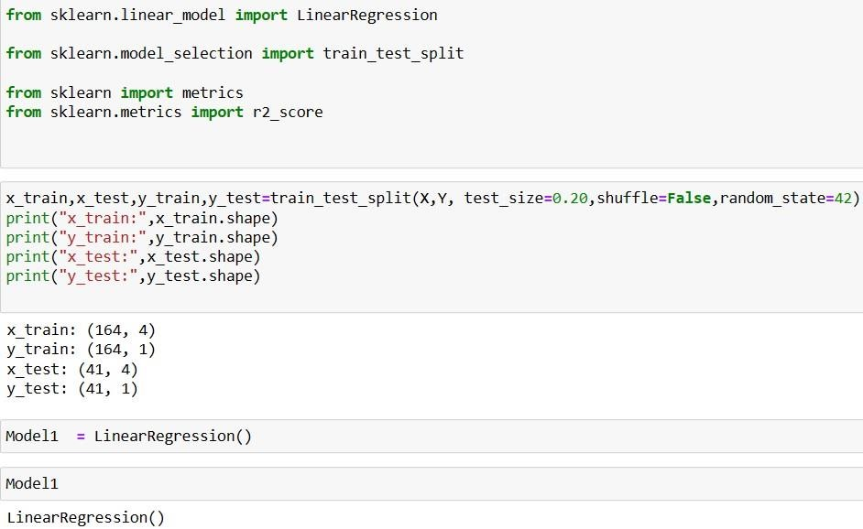
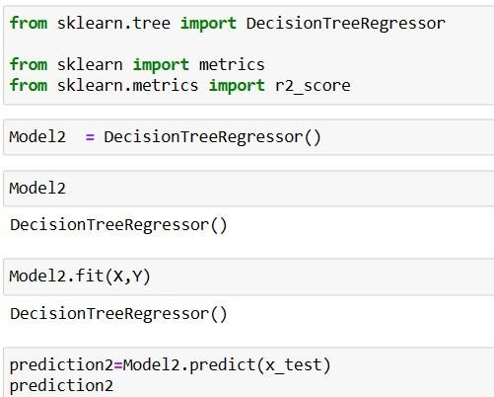
Linear Regression
Decision Tree Regressor
Fig 2.2

Slide 9
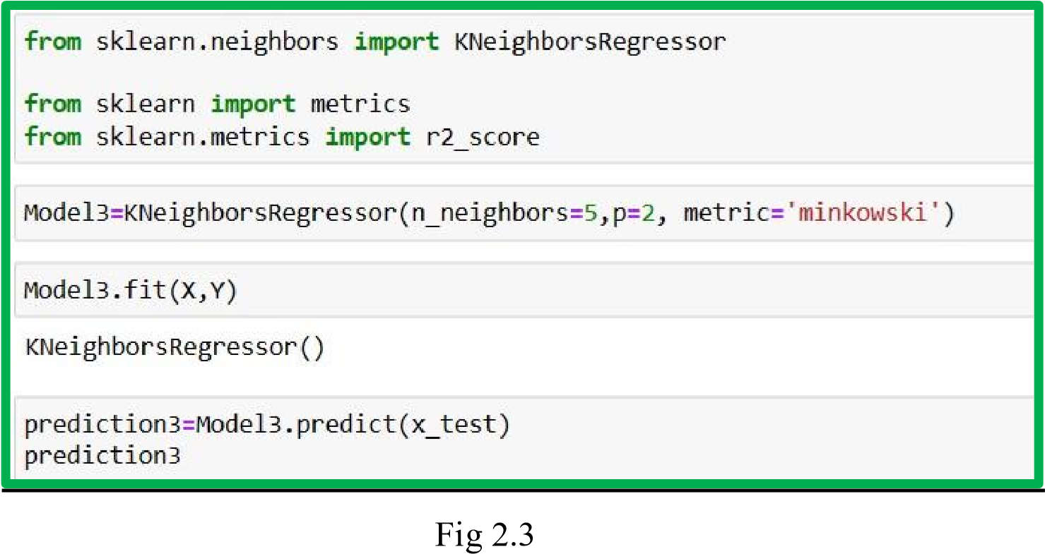
Kneighbor Regressor

Slide 10
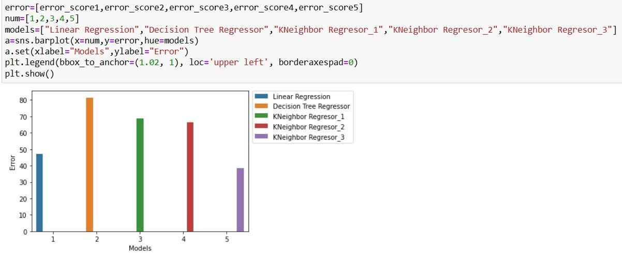
Model Training and Evaluation

Slide 11
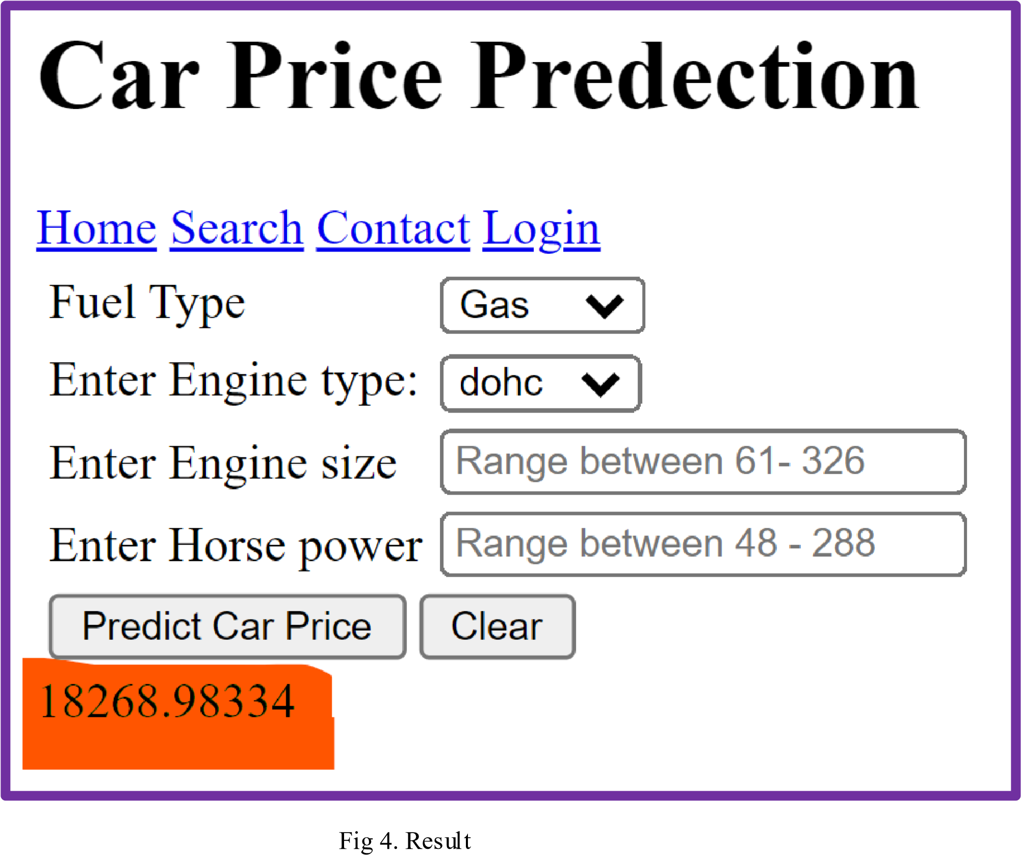
RESULTS

Slide 12
Discussion
The results of this study demonstrate that machine learning models, particularly ensemble methods like Random Forest and Gradient Boosting, can significantly improve the accuracy of car price prediction compared to traditional approaches like Linear Regression. The ability of these models to capture complex interactions between features, such as the age of the car, mileage, and engine size, allows for more precise predictions.
However, the effectiveness of the model heavily relies on data quality. Missing values, outliers, and irrelevant features can negatively impact the model's performance. Preprocessing steps like feature selection, normalization, and handling missing data play a crucial role in improving accuracy.
Moreover, the analysis of feature importance revealed that factors like car make, model, year of manufacture, and mileage are the most significant determinants of car price. By incorporating these key features into predictive models, we can provide useful insights for stakeholders in the used car market.
Future work could explore the use of deep learning models and incorporate additional features such as market trends and customer reviews to further improve accuracy.

Slide 13
Conclusion
This study demonstrates the effectiveness of machine learning techniques in predicting used car prices. Among the models tested, ensemble methods like Random Forest and Gradient Boosting outperformed simpler models such as Linear Regression, due to their ability to handle complex, non-linear relationships between car features. Key factors influencing car prices, such as make, model, year, and mileage, were identified through feature importance analysis.
The results highlight the potential of machine learning to offer accurate, data-driven insights that benefit both buyers and sellers in the used car market. However, the accuracy of predictions depends on data quality and proper preprocessing. While this study provides a strong foundation for car price prediction, future research could explore incorporating additional factors like market demand, reviews, and regional pricing trends to further refine the models.
In conclusion, machine learning offers a promising tool for enhancing decision-making in the used car industry, providing a more efficient and accurate way to estimate car prices.

Slide 14
References
[01] Kishor K., Pandey D. (2022). Study and Development of Efficient Air Quality Prediction System Embedded with Machine Learning and IoT. In Deepak Gupta et al. (Eds), Proceeding International Conference on Innovative Computing and Communications. Lect. Notes in Networks, Syst., Vol. 471, Springer, Singapore, https://doi.org/10.1007/978-981-19-2535-1_24.
[02] K.Samruddhi, & Kumar, D. R. (2020, September). Used Car Price Prediction using KNearest Neighbor Based Model. International Journal of Innovative Research in Applied Sci-ences and Engineering (IJIRASE), 4(3), 686-689.
[03] Samruddhi, K.; Kumar, R.A. Used Car Price Prediction using K-Nearest Neighbor Based
Model. Int. J. Innov. Res. Appl. Sci. Eng. 2020, 4, 629–632.
[04] Kaushal Kishor " Study of quantum computing for data analytics of predictive and prescriptive analytics models”, Book Chapter in “Quantum-Safe Cryptography”, DE GRUYTER, PP. 121-146., 2023, ISBN 978-3-11-079800-5 e-ISBN (PDF) 978-3-11079815-9 e-ISBN (EPUB) 978-3-11-079836-4 ISSN 2940-0112, DOI:
https://doi.org/10.1515/9783110798159010.
[05] https://github.com/Inderdev07
[06] https://github.com/Inderdev07/car-price-prediction
[07] https://github.com/Inderdev07/car-price-prediction/blob/main/CarPrice_Assignment.csv
[08] https://colab.research.google.com/drive/1d83lrxcMinjhxpClfvl0jjgh75BhEIom

Slide 15
THANKS

